Slide 1
Announcements
Office Hours change: Mon 3:30-4:30pm, Wed 1-2pm (both in DL 580)
AI Seminar Series: Fridays 3-4pm in DL 480
Schedule here: http://web.cse.ohio-state.edu/lair/seminars.html
If on waitlist, submit HW0 by emailing me (also please speak to me after class!)
HW0 DUE 8/30

Slide 2
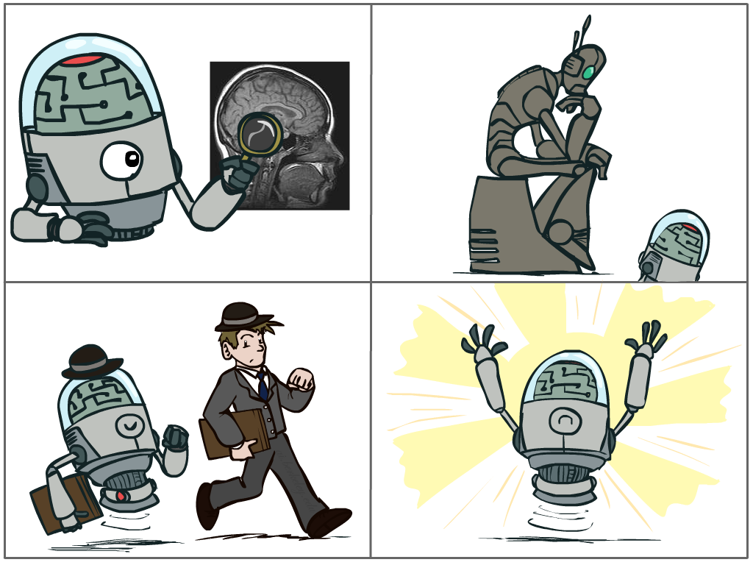
What is AI?
The science of making machines that:
Think like people
Think rationally
Act like people
Act rationally
Notes:
Top left: Think like people --- cognitive science, neuroscience
Bottom left: act like people --- actually very early definition, dating back to Alan Turing --- Turing test; problem to do really well you start focusing on things like don’t answer too quickly what the square root of 1412 is, don’t spell too well, and make sure you have a favorite movie etc. So it wasn’t really leading us to build intelligence
Think rationally – long tradition dating back to Aristotle --- but not a winner, because difficult to encode how to think, and in the end it’s not about how you think, it’s about how you end up acting

Slide 3
Fundamental question for this lecture (and really this whole class!):
How do you turn a real-world problem into an AI solution?

Slide 4
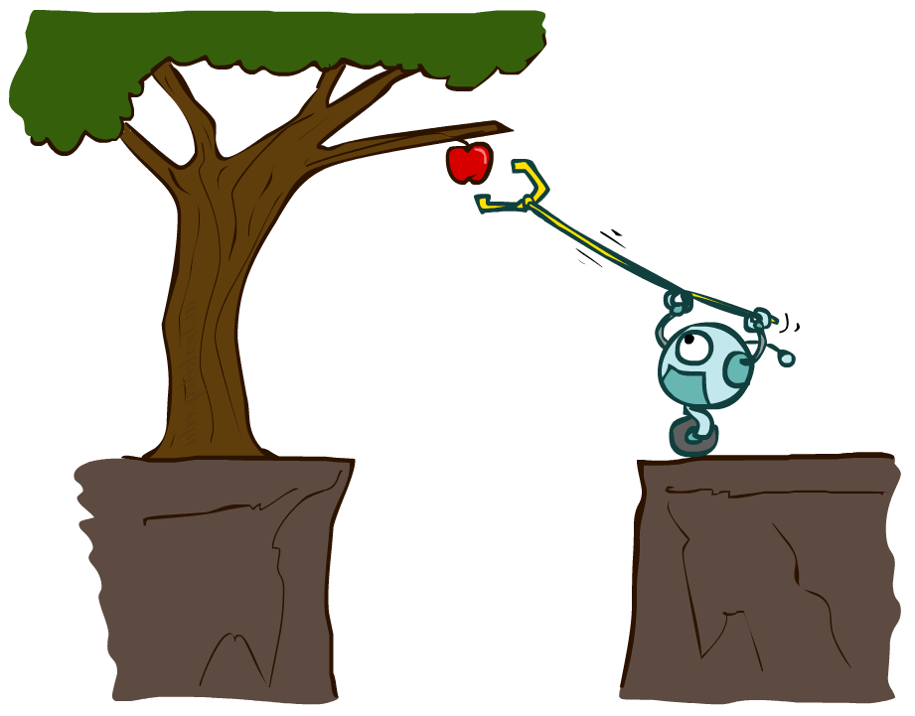
AI – Agents and Environments
Much (though not all!) of AI is concerned with agents operating in environments.
Agent – an entity that perceives and acts
Environment – the problem setting

Slide 5
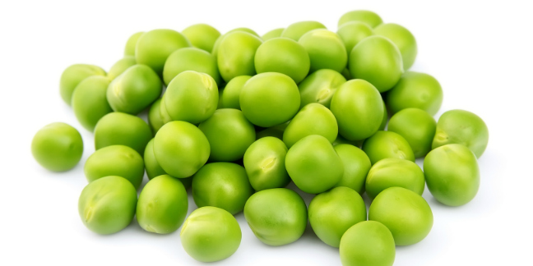
Fleshing it out

Slide 6
Fleshing it out
Performance – measuring desired outcomes
Environment – what populates the task’s world?
Actuators – what can the agent act with?
Sensors – how can the agent perceive the world?

Slide 7

Arnold’s PEAS?

Slide 8
PEAS in a taxi
Automated taxi driver
Performance – Safe, fast, legal, comfortable trip, maximize profits
Environment – Roads, other traffic, pedestrians, customers
Actuators – Steering, accelerator, brake, signals, horn, display
Sensors - Cameras, sonar, speedometer, GPS, odometer, accelerometer, engine sensors, microphone/keyboard

Slide 9
Exercise - pick some PEAS
Group 1 | Group 2
Group 3 | Group 4
Grocery store shelf-stocking robot
Twitter bot to flag hate speech
Performance
Environment
Actuators
Sensors
Medical diagnosis system
Interactive English tutor
Notes:
Students count off 1-4, go to different corners of the room. 10 minutes to discuss PEAS for each task, then we come back together to go over them.
Goal: get students thinking about breaking down the components of a problem, see that AI applications range widely

Slide 10
What makes an Agent?
Agent – an entity that perceives its environment through sensors, and acts on it with actuators.
Percepts are constrained by
Sensors + Environment
Actions are constrained by
Actuators + Environment
Sensors
Agent
Percepts
Environment
?
Actuators
Actions
Agent Function – how does it choose the action?

Slide 11
What makes one rational?
Actually pretty simple:
A rational agent always acts to maximize its expected performance measure, given current state/percept
Not the same as omniscience (knowing the actual outcome of an action, instead of the expected outcome); can’t account for a piano falling from the sky.

Slide 12


Our sample agents
Pacman
Percepts – squares around Pacman
Actions – move U/D/L/R
Environment – map with walls, dots, and ghosts
Spam detector
Percepts – sender, subject line, body of current email
Actions – mark Spam/Not Spam
Environment – your email inbox

Slide 13
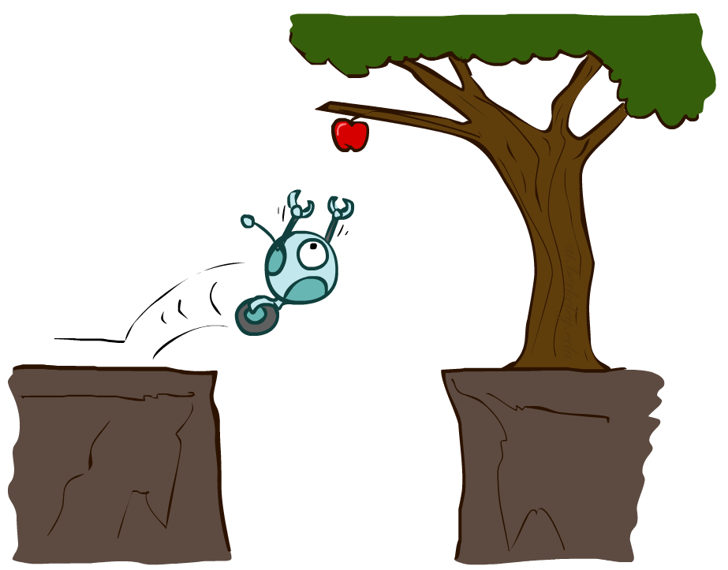
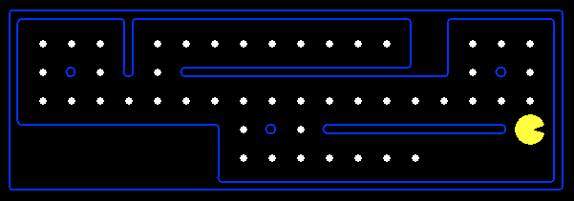
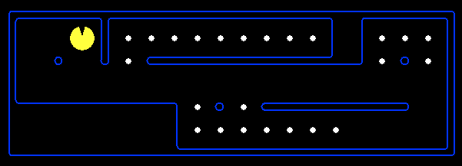
Reflex Agents
Reflex agents:
Choose action based on current percept (and maybe memory)
May have memory or a model of the world’s current state
Do not consider the future consequences of their actions
Consider how the world IS
Notes:
Examples: blinking your eye (not using your entire thinking capabilities), vacuum cleaner moving towards nearest dirt

Slide 14
Simple Reflex Agent
Chooses action based on current percept alone
Pacman
Percepts – squares around Pacman
Actions – move U/D/L/R
Environment – map with walls, dots, and ghosts
[DEMOS]
Spam detector
Percepts – sender, subject line, body of current email
Actions – mark Spam/Not Spam
Environment – your email inbox
Agent function:
if hasNigerianPrince(body): return SPAM
else: return NOTSPAM

Slide 15
Model Reflex Agent
Chooses action based on current percept and internal model of environment
Pacman
Percepts – squares around Pacman
Actions – move U/D/L/R
Environment – map with walls, dots, and ghosts
Model – which squares have I eaten dots in?
Spam detector
Percepts – sender, subject line, body of current email
Actions – mark Spam/Not Spam
Environment – your email inbox
Model – per-sender message history
Agent function:
if haveExchangedEmails(sender): NOTSPAM
elif hasNigerianPrince(body): return SPAM
else: return NOTSPAM

Slide 16
Reflex Agents
Reflex agents:
Choose action based on current percept (and maybe memory)
May have memory or a model of the world’s current state
Do not consider the future consequences of their actions
Consider how the world IS
Can a reflex agent be rational?
Notes:
Examples: blinking your eye (not using your entire thinking capabilities), vacuum cleaner moving towards nearest dirt

Slide 17
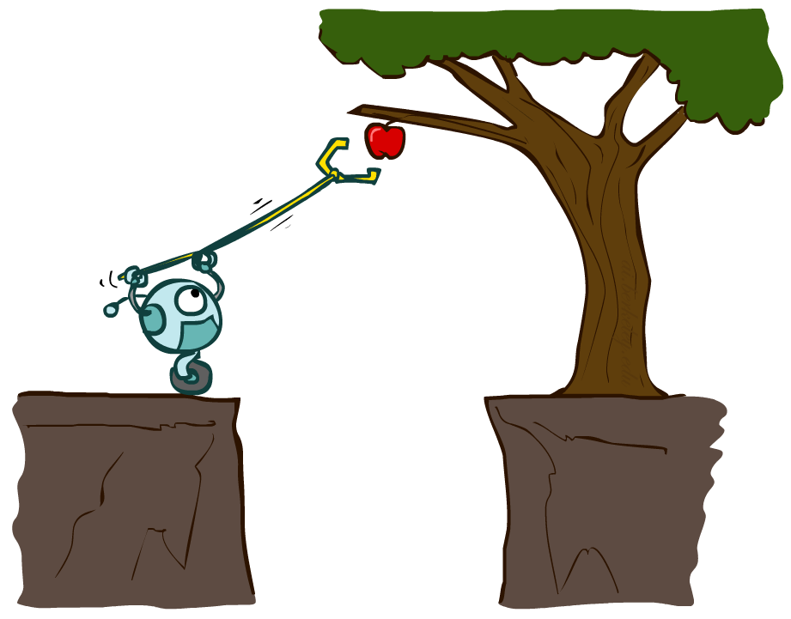
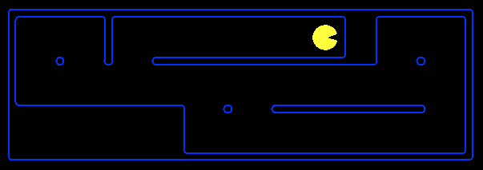
Planning Agents
Planning agents:
Ask “what if”
Decisions based on (hypothesized) consequences of actions
Must have a model of how the world evolves in response to actions
Must formulate a goal (test)
Consider how the world WOULD BE

Slide 18
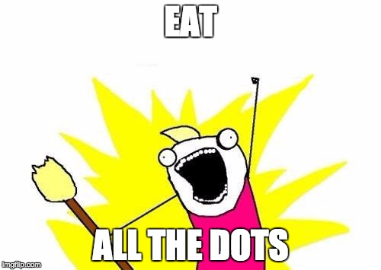
Goal-based Agents
Chooses action (sequence) to get from current state to some goal
Pacman
Percepts – squares around Pacman
Actions – move U/D/L/R
Environment – map with walls, dots, and ghosts
Goal:
Spam detector
Percepts – sender, subject line, body of current email
Actions – mark Spam/Not Spam
Environment – your email inbox
Goal:
???

Slide 19
Utility-based Agents
Chooses action (sequence) to get from current state to some goal
with maximum utility along the way
Pacman
Percepts – squares around Pacman
Actions – move U/D/L/R
Environment – map with walls, dots, and ghosts
Goal:
Spam detector
Percepts – sender, subject line, body of current email
Actions – mark Spam/Not Spam
Environment – your email inbox
Goal:
???
???
…in as short a path as possible!

Slide 20
Summary
Reflex agents
Act on current state (and maybe past)
Simple – current percept only
Model – current percept and model
of rest of environment
Goal-based agents
From current state to desired future
Goal-only – find any action(s) to
reach the goal
Utility – find best action(s) to
reach the goal
Can also have a Learning Agent – we’ll talk about these later in the course!

Slide 21
AI – Agents and Environments
Much (though not all!) of AI is concerned with agents operating in environments.
Agent – an entity that perceives and acts
Environment – the problem setting

Slide 22
Kinds of task environments
6 common properties to distinguish tasks (not exhaustive)
Fully observable vs Partially observable
Single agent vs Multiagent
Deterministic vs Stochastic
Episodic vs Sequential
Static vs Dynamic
Discrete vs Continuous

Slide 23
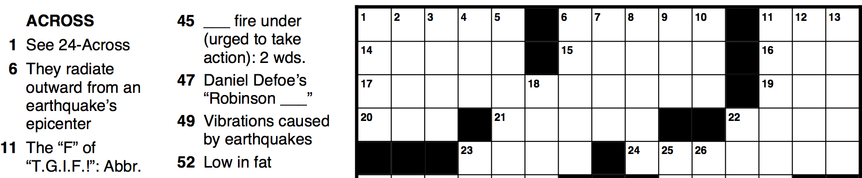

Fully observable vs partially observable
Fully observable – agent is able to sense everything in the environment
Partially observable – noisy, inaccurate, or incomplete sensors

Slide 24
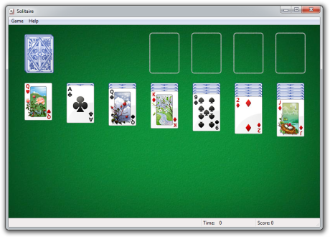
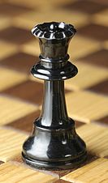

Single agent vs Multiagent
Single agent – self-explanatory
Multiagent – task involves more than one agent, each with its own performance measure
May be competitive (measures are opposed)
or cooperative (measures align)

Slide 25
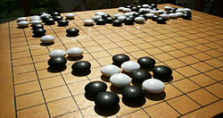
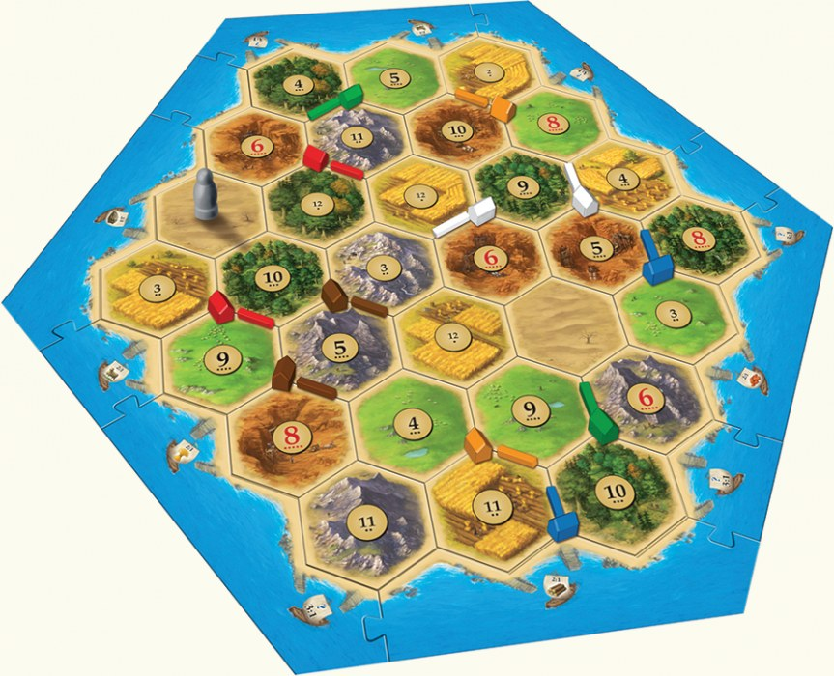
Deterministic vs Stochastic
Deterministic – next state of the world is fully determined by
current state + agent action
Stochastic – it’s not deterministic

Slide 26
Episodic vs Sequential
Episodic – Each step/decision is independent of the previous ones
Sequential – Each step/decision affects later ones

Slide 27
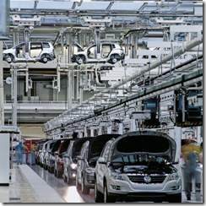
Static vs Dynamic
Static – world doesn’t change while agent is choosing an action
Dynamic – decision time matters!

Slide 28

Discrete vs Continuous
Discrete – possible states/actions are distinct; world changes discretely
Continuous – states/actions take on continuous values

Slide 29
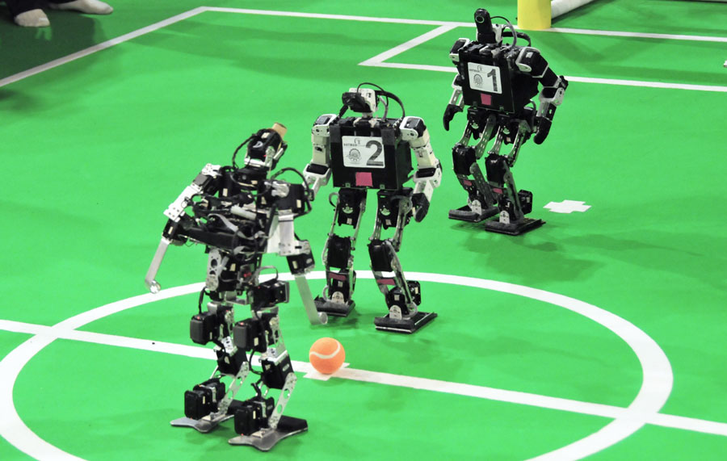
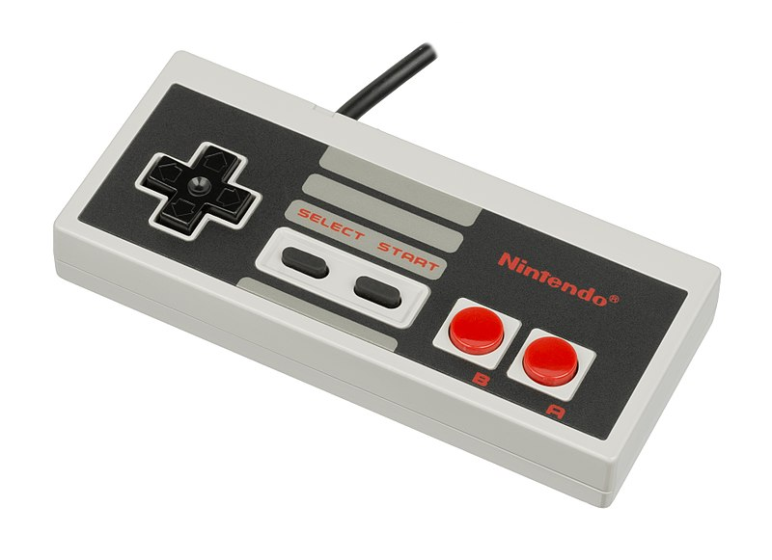
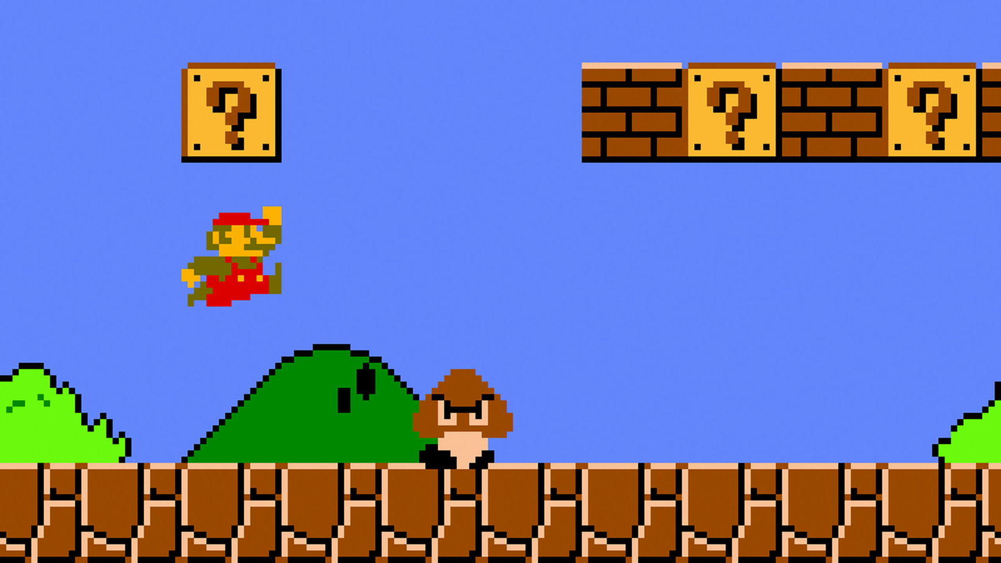
Bonus: level of agent knowledge
Environment is known – agent knows the “rules” of the world
Environment is unknown – agent has partial knowledge of the rules
???
Notes:
Note that an environment can be unknown but fully observed (e.g. a new game where you don’t know the controls)

Slide 30
Kinds of task environments
6 common properties to distinguish tasks (not exhaustive)
Fully observable vs Partially observable
Single agent vs Multiagent
Deterministic vs Stochastic
Episodic vs Sequential
Static vs Dynamic
Discrete vs Continuous
Exercise: classify some real tasks!

Slide 31
These help determine how to approach problems
Static -> can focus on getting really high accuracy/utility
Dynamic -> trade some utility for higher efficiency (speed!)
Episodic -> reflex agent with a great model
Sequential -> need a goal-oriented agent
Stochastic -> need robustness to uncertainty/failure (robots!)
Deterministic -> can focus on efficiency and exactness (Internet crawler)

Slide 32
Next up
Defining search problems – how to choose the right action sequence?
Uninformed search approaches – simple reflex agents for searching

